Slide 1


or
I am John Lester Labrador Enriquez
My friends call me
Kitt
Hello
Jong

Slide 2
I was born on the 30th of May 2000
I am John Lester Labrador Enriquez
My friends call me
in the City of Balanga in Bataan
Jong
Kitt
or
I grew up and still currently live in Bantan Orion Bataan
Hello

Slide 3
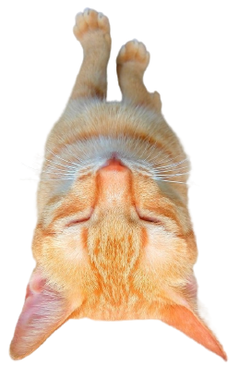
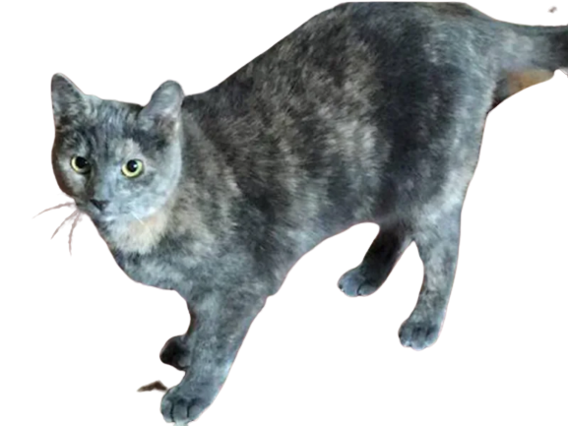
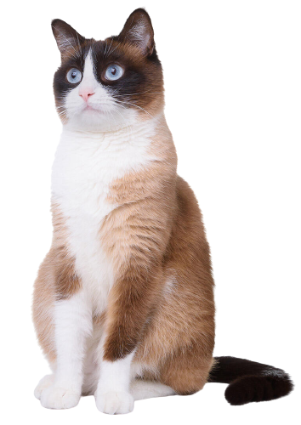
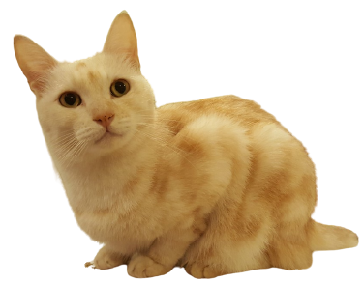
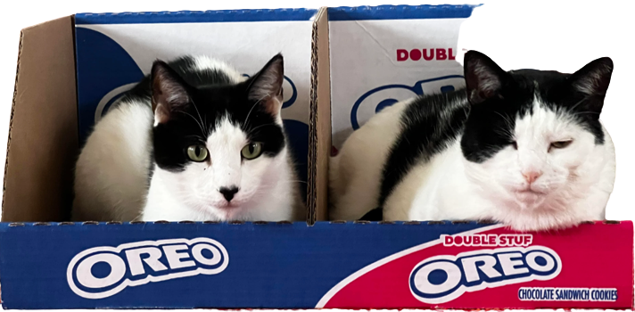
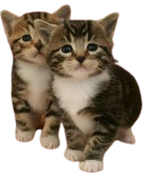
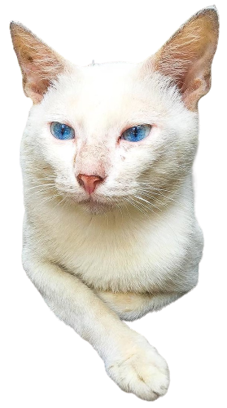
Jong
I have 9 cats
Punggok
Tiger
I am John Lester Labrador Enriquez
I was born on the 30th of May 2000
My friends call me
in the City of Balanga in Bataan
Kitt
Xia
I grew up and still currently live in Bantan Orion Bataan
Shy
Batman
Miming
Pichi
Pichu
Puti
or

Slide 4







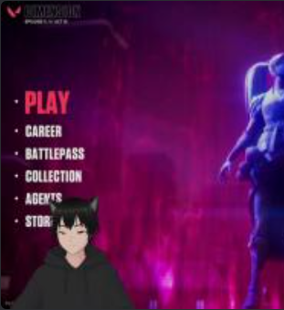
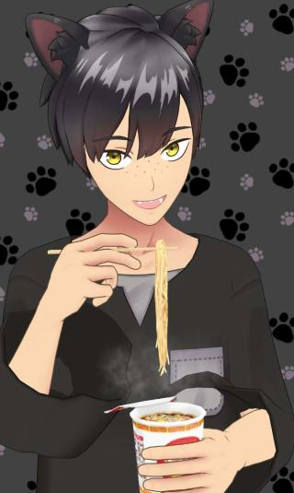
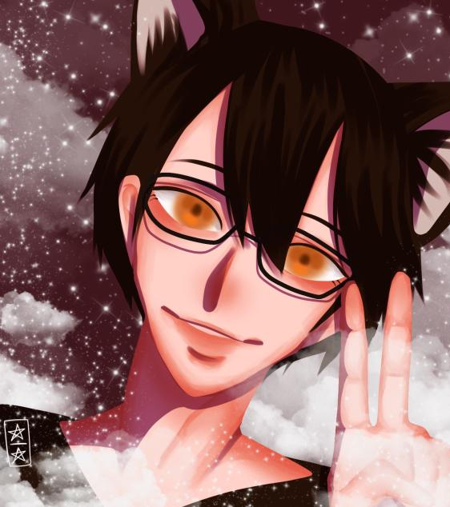
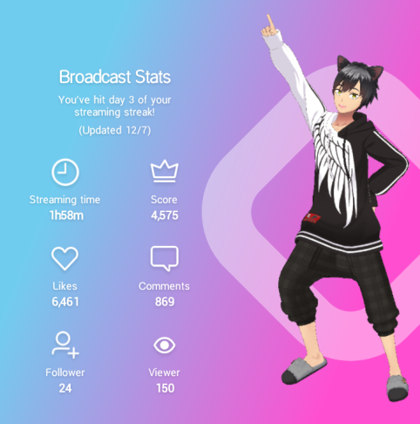
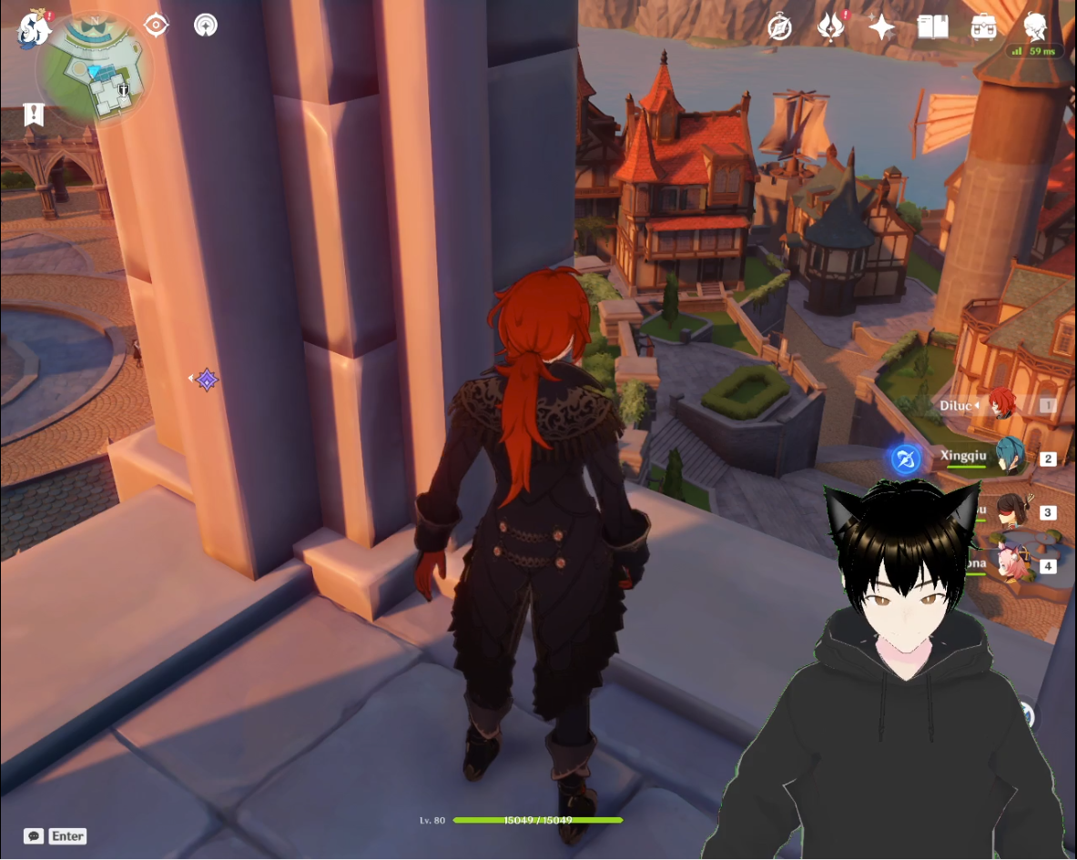



Watch anime and other movies
I play videogames
I have 9 cats
Tiger
in the City of Balanga in Bataan
Punggok
Xia
Pichi
Pichu
etc
I grew up and still currently live in Bantan Orion Bataan
Puti
Shy
Batman
Miming
As for my hobbies
A little bit of streaming just for fun
I was born on the 30th of May 2000
Read manga/manhwa

Slide 5
Xia
Pichi
Pichu
Watch anime and other movies
I play videogames
Tiger
etc
Puti
Shy
Batman
Miming
Read manga/manhwa
As for my hobbies
A little bit of streaming just for fun
I have 9 cats
Punggok
Thank You

Slide 6
Watch anime and other movies
I play videogames
Thank You
etc
As for my hobbies
A little bit of streaming just for fun
Read manga/manhwa

